Slide 1
Week 7 Internship
Samarth Sharma

Slide 2
SVD on the board (Arch1)
Float 50x50

Slide 3
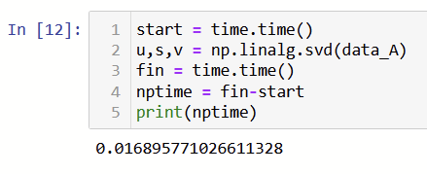
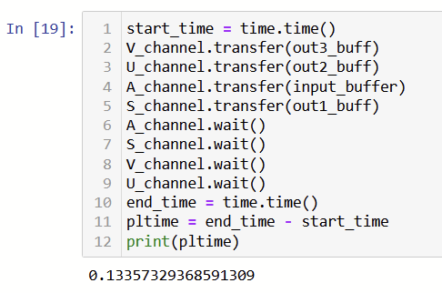


SVD testing
PS Impl1: NumPy
PL
PS Impl2: A@AT, AT@A
PS Impl3: Householder->AAT

Slide 4





Slide 5
SVD on the board (Arch1)
Complex float 100x100

Slide 6
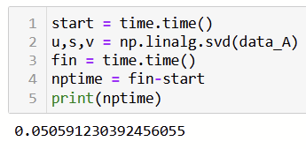
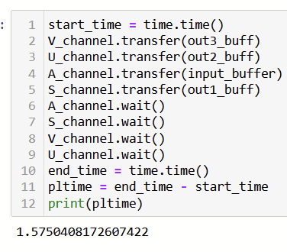
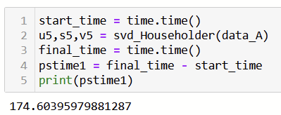

SVD testing (100x100 complex)
PS Impl1: NumPy
PL
PS Impl2: Householder -> A@AH
PS Impl3: A@AH

Slide 7


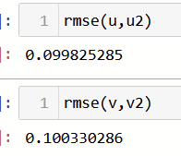
Eigenvectors not matching but matrix is being reconstructed correctly

Slide 8
32 packets ESPRIT

Slide 9
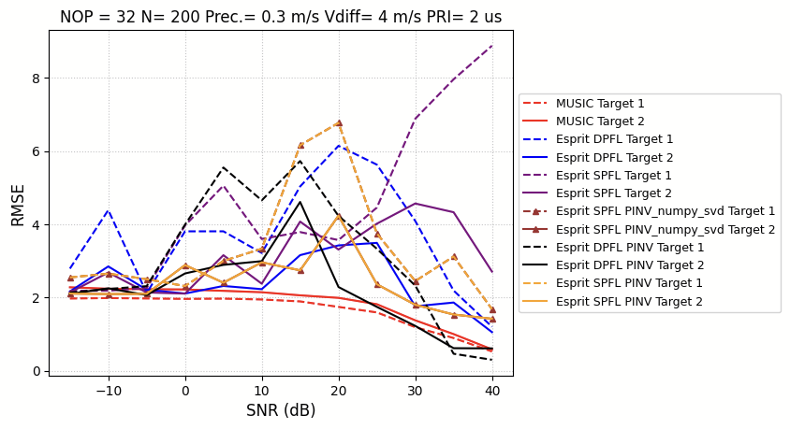

Slide 10
ESPRIT with HLS SVD IP

Slide 11
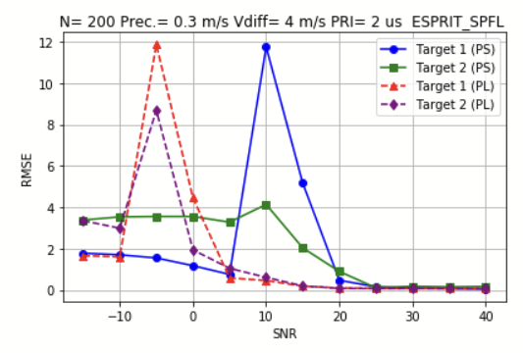
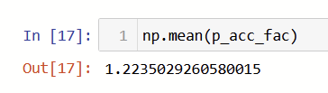
For 5 runs

Slide 12
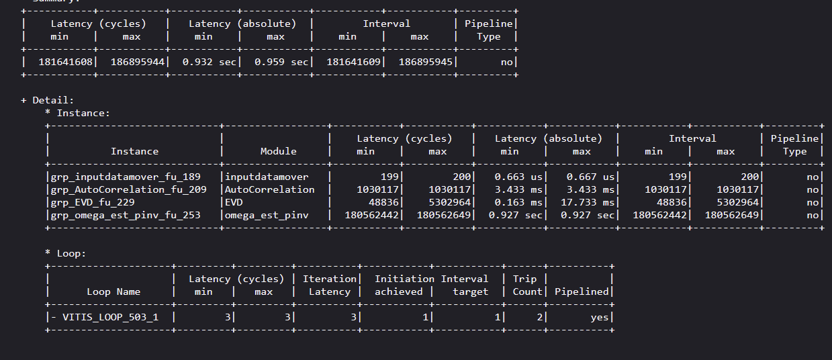
50 lakh ->18cr

Slide 13
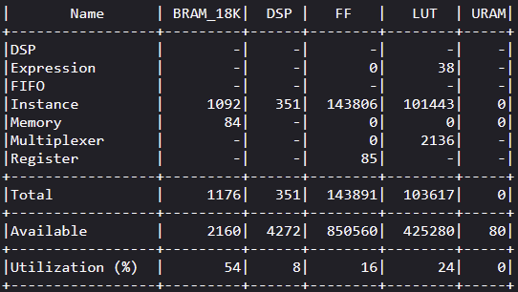

Slide 14
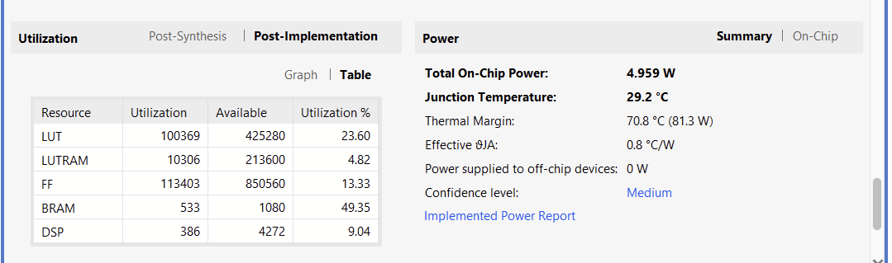

Slide 15
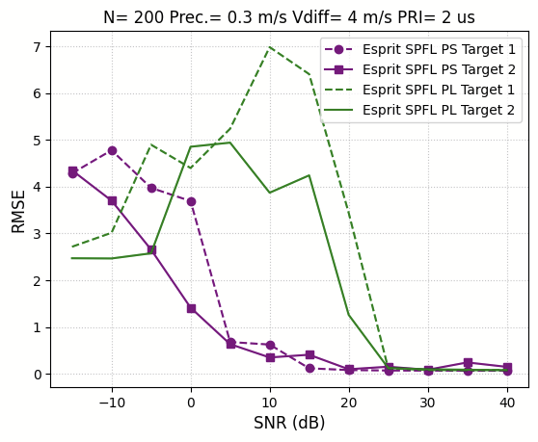

For 200 runs

Slide 16
Pseudo-inverse using Golub Kahan - Complex

Slide 17
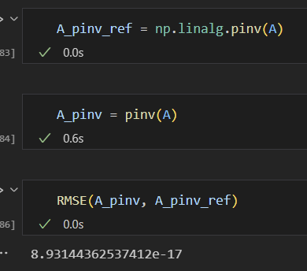
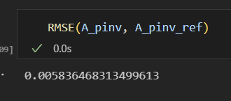
Using numpy qr
Using givens
99x2

Slide 18
Thank you!!

